Slide 1

Learning with VR
Team Members: Edvin Li, Deon Davis Product Owner:Shahin Vassigh
Instructor: Masoud Sadjadi School of Computing and Information Sciences Florida International University
Final Presentation
Summer 2017
Notes:
7 seconds.( I will select 2 best slides (i will give them extra points and students will present for CIS committee)
Greet your audience, thank them for attending your presentation, introduce yourself, introduce your project, introduce your team members, and quickly indicate what each of you did in a high-level manner, and put more emphasis on your part/contribution.

Slide 2
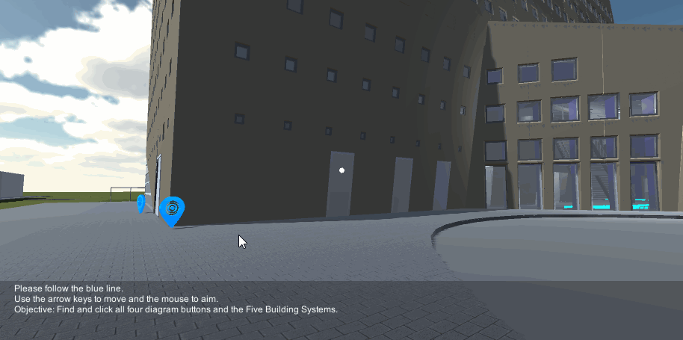



Project definition
Notes:
10 seconds.
Introduce the problem that the whole project (in all versions) tackles with GIF or screenshot.

Slide 3
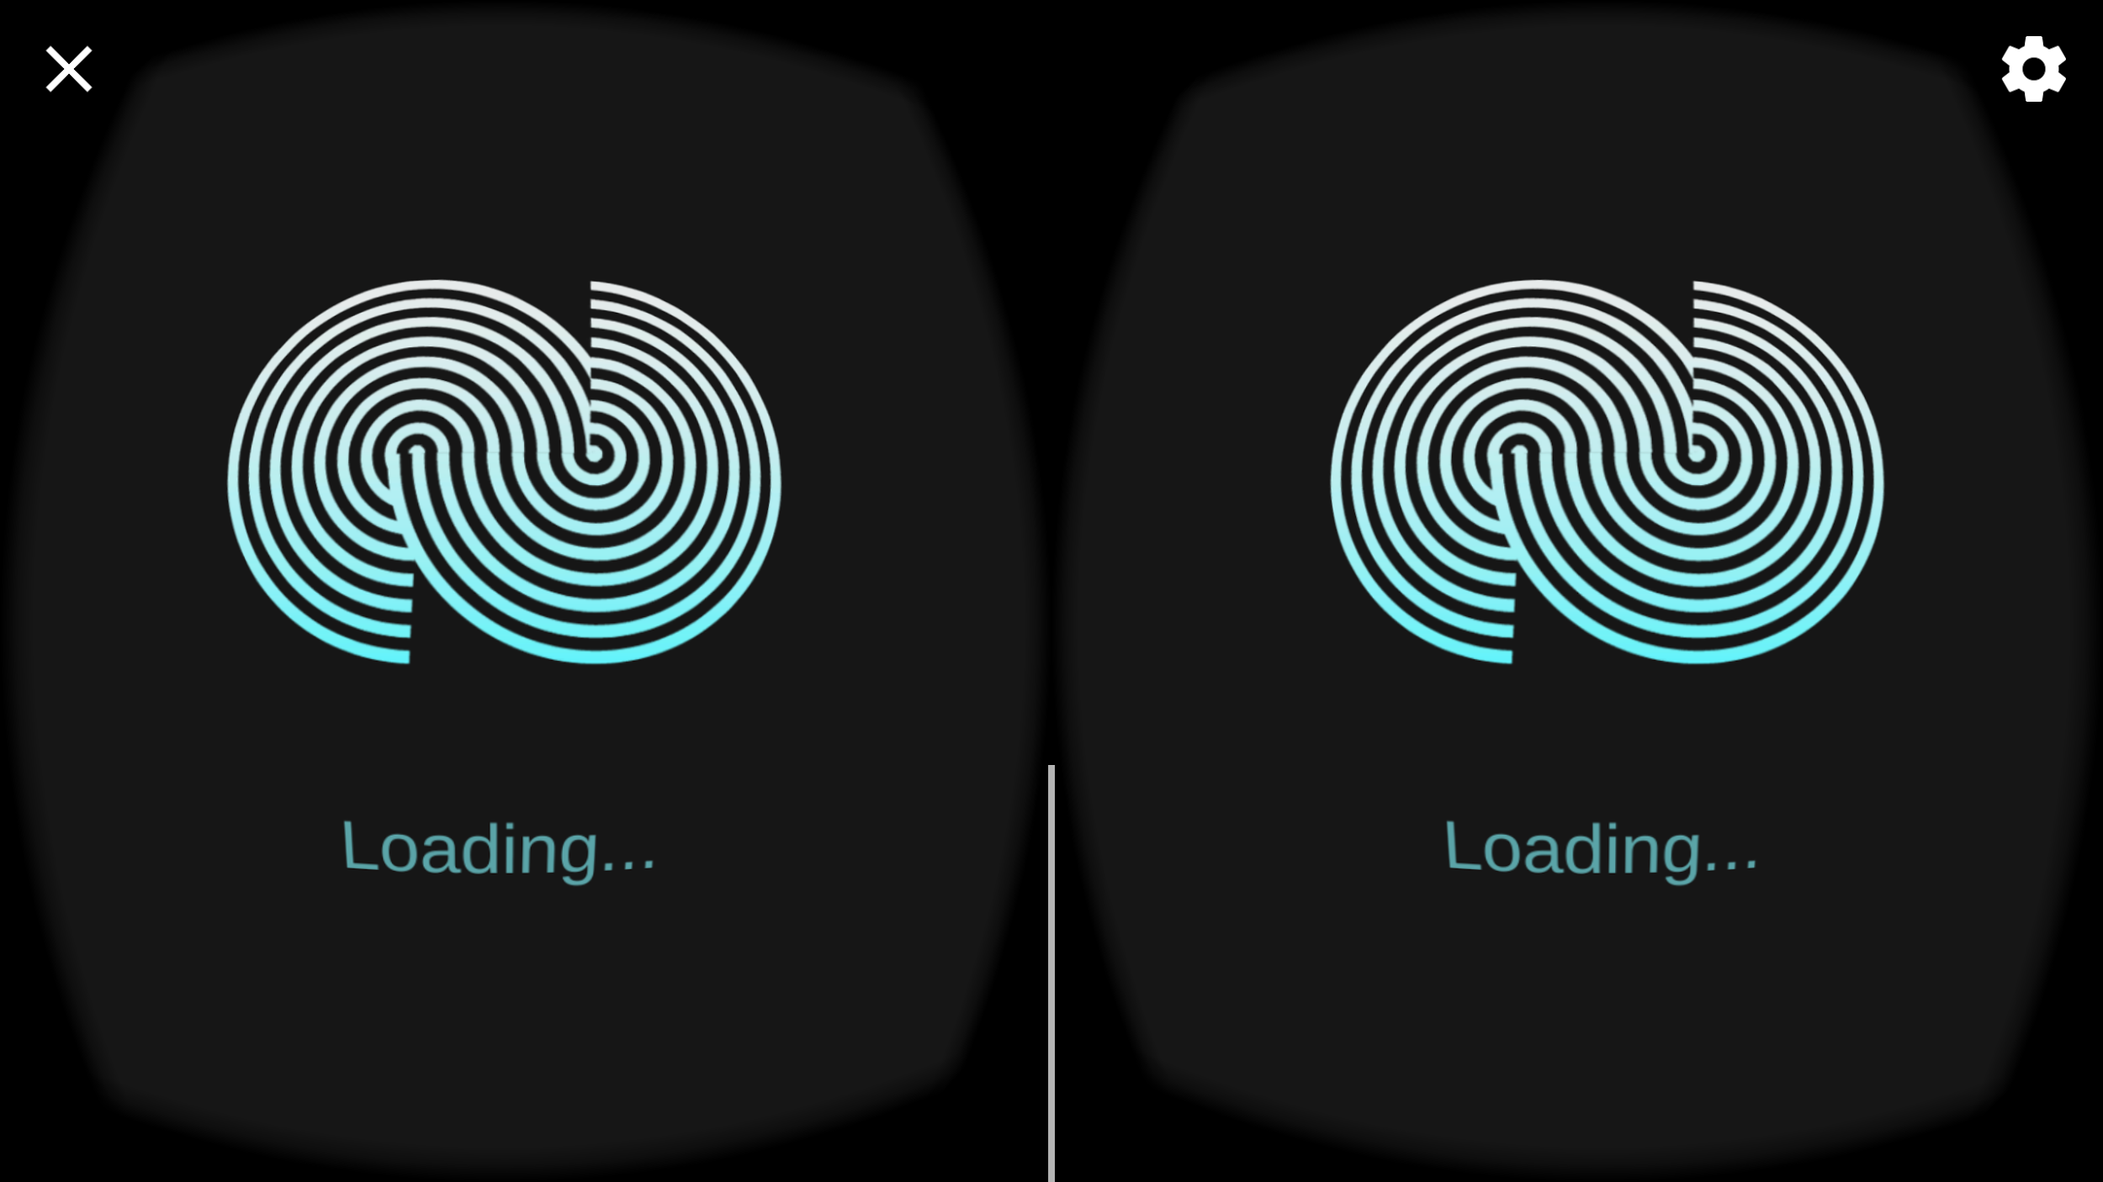
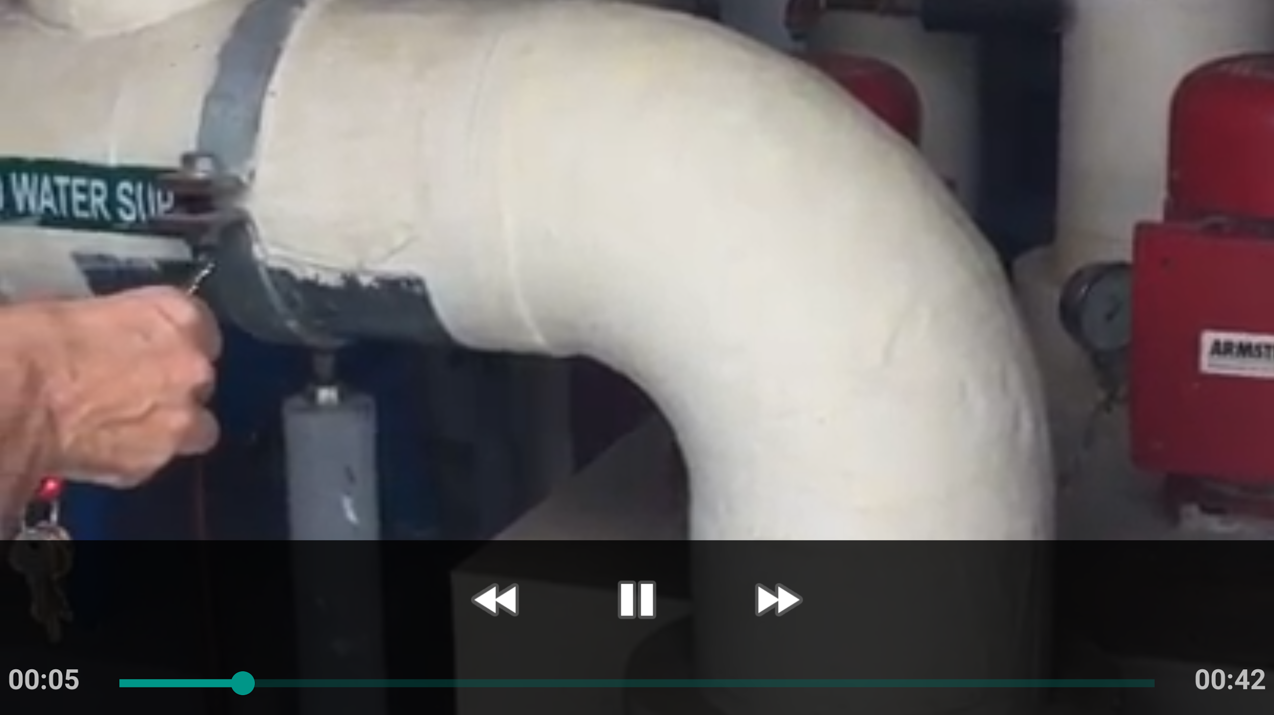
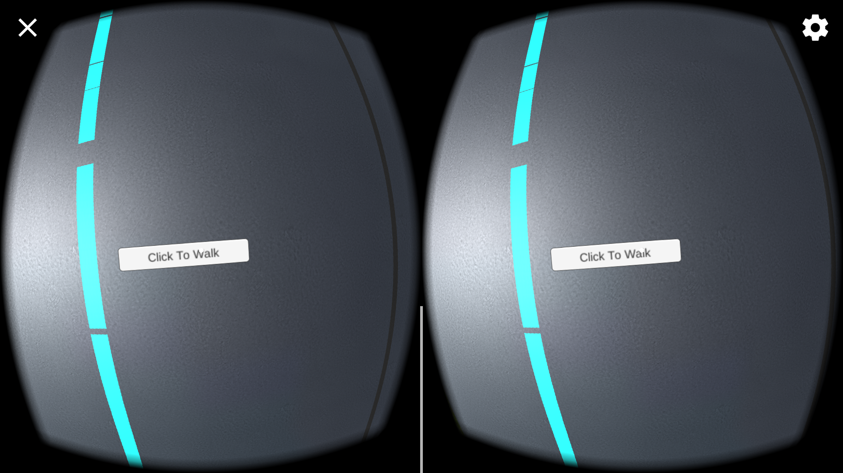


Project definition
Notes:
20 seconds.
Introduce the problem that the your project (in new version) tackles with GIF or screenshot.

Slide 4
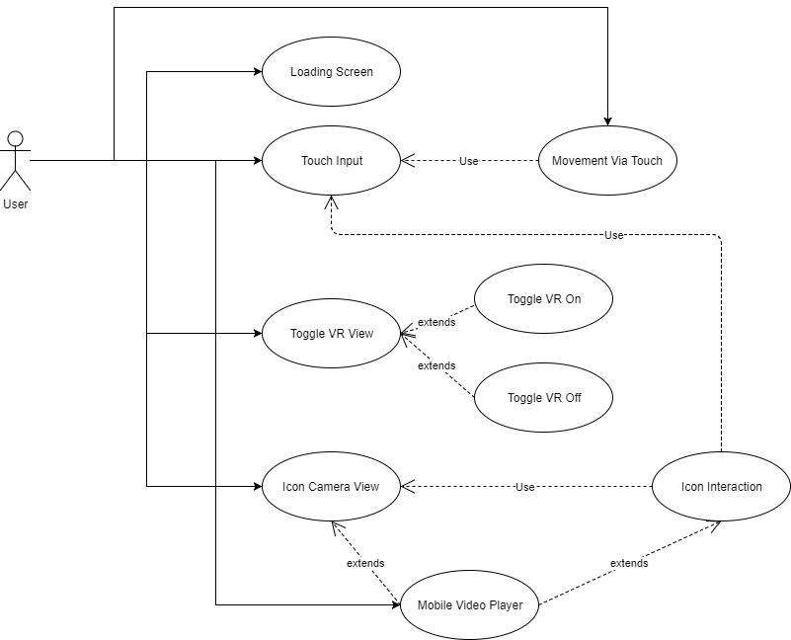
Requirements: Use Cases
Notes:
5 seconds
Show the Use Case Diagram for the whole project. Highlight your use cases.

Slide 5
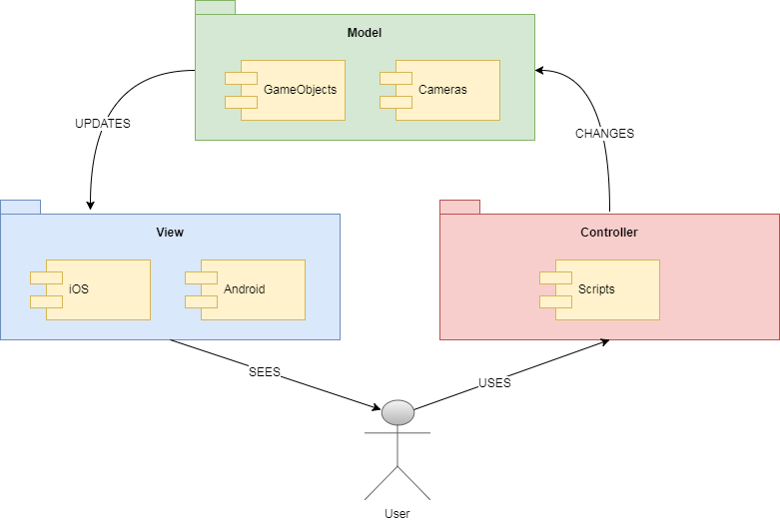
System Design: Architecture
Notes:
20 seconds
System design: Highlight the parts that you contributed to them.
1. System decomposition; identify the architecture patterns used
2. System deployment – h/w and s/w requirements

Slide 6
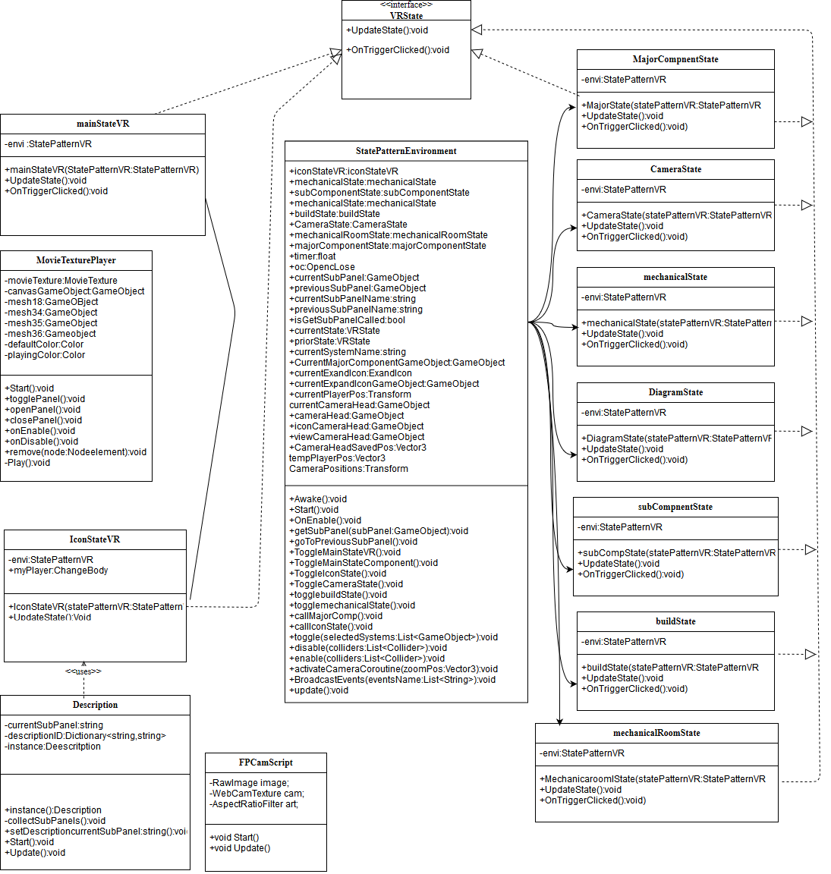
Minimal Class Diagram
Notes:
10 seconds.Minimal class diagram. Highlight the classes that you created/modified
Identify the design patterns used (one or more slides).

Slide 7
User Stories
Loading Screen
Touch Input
Movement Via Touch
Mobile Video Player
Icon Camera View
Icon Interaction
Toggle VR View
Notes:
5 seconds.
List the user stories that you worked on them.(put in order of importance). Stay focused on the parts that you have been working.

Slide 8
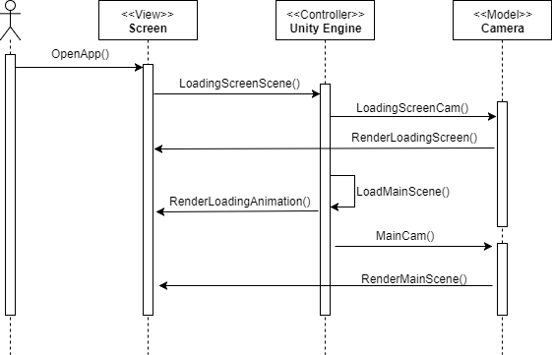
User Story #1 - #219 Loading Screen
Provides a way for users to know whether the application is still responsive.
Due to a long loading time, an animated loading screen is crucial in letting the user know that the application still needs more time.
Notes:
60 seconds
The tile of user story
The most important user story you worked on it. You have to describe this one very well and be proud of that.
Please present and show the complexity of your work, code, algorithms, and technical challenges and technologies you have used. (you could use screenshot if you want. Visual presentations are better than text presentation)
Go into the details of the most important/significant tasks using bullet lists or visual graphs or state chart diagram
Sequence Diagram for this user story is mandatory (in another separate page if required)
Demo using screenshots or GIF (in another separate page if required)

Slide 9
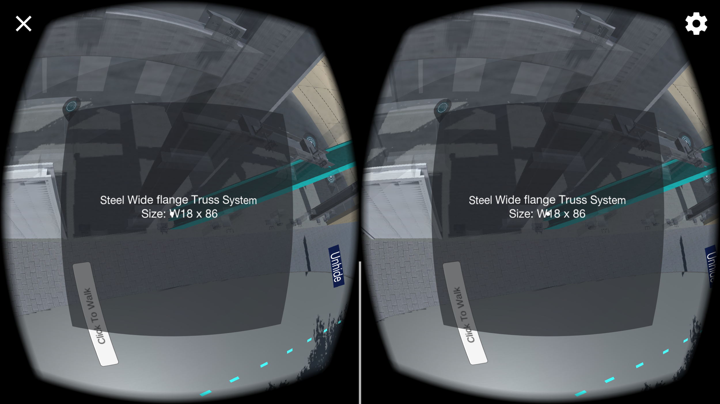
User Story #2 - #224/225 Touch Input
A way for mobile users to provide inputs for the application.
Also, needs to keep track of number of fingers being used.
Essential for various interactions in application.
Notes:
20 seconds
The tile of user story
Please present and show the complexity of your work, code, algorithms, and technical challenges and technologies you have used. (you could use screenshot if you want. Visual presentations are better than text presentation) - Go into the details of the most important/significant tasks using bullet lists or visual graphs or state chart diagram - Demo using screenshots or GIF (in another separate page if required)
Sequence Diagram for this user story is optional

Slide 10
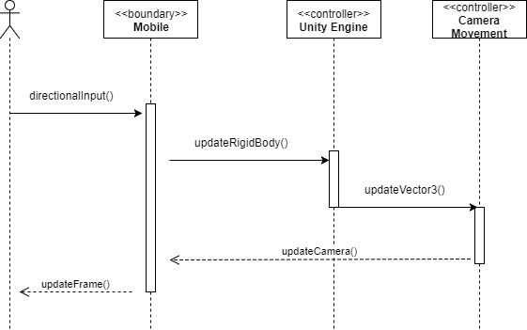
User Story #3 - #217 Movement Via Touch
Movement can be activated by touching the “Click to walk” button when looking down, or two finger press.
Either action will activate the auto walk script.
The camera is set to first person and is the object being moved.
Notes:
20 seconds
The tile of user story
Please present and show the complexity of your work, code, algorithms, and technical challenges and technologies you have used. (you could use screenshot if you want. Visual presentations are better than text presentation) - Go into the details of the most important/significant tasks using bullet lists or visual graphs or state chart diagram - Demo using screenshots or GIF (in another separate page if required)
Sequence Diagram for this user story is optional

Slide 11
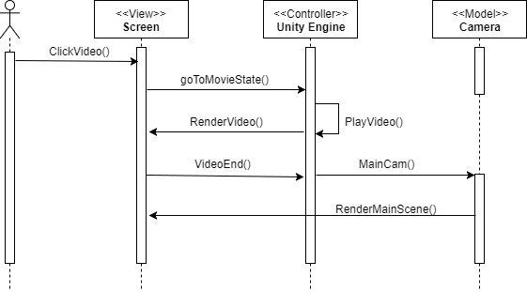
User Story #4 - #219 Mobile video player
One of the educational aspects of this project. Videos showing the inside of certain areas from SIPA.
Linked to Icons and switches users to a different state. Also needs video playing capability.
Notes:
20 seconds
The tile of user story
Please present and show the complexity of your work, code, algorithms, and technical challenges and technologies you have used. (you could use screenshot if you want. Visual presentations are better than text presentation) - Go into the details of the most important/significant tasks using bullet lists or visual graphs or state chart diagram - Demo using screenshots or GIF (in another separate page if required)
Sequence Diagram for this user story is optional

Slide 12
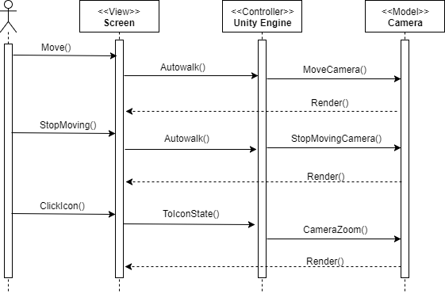
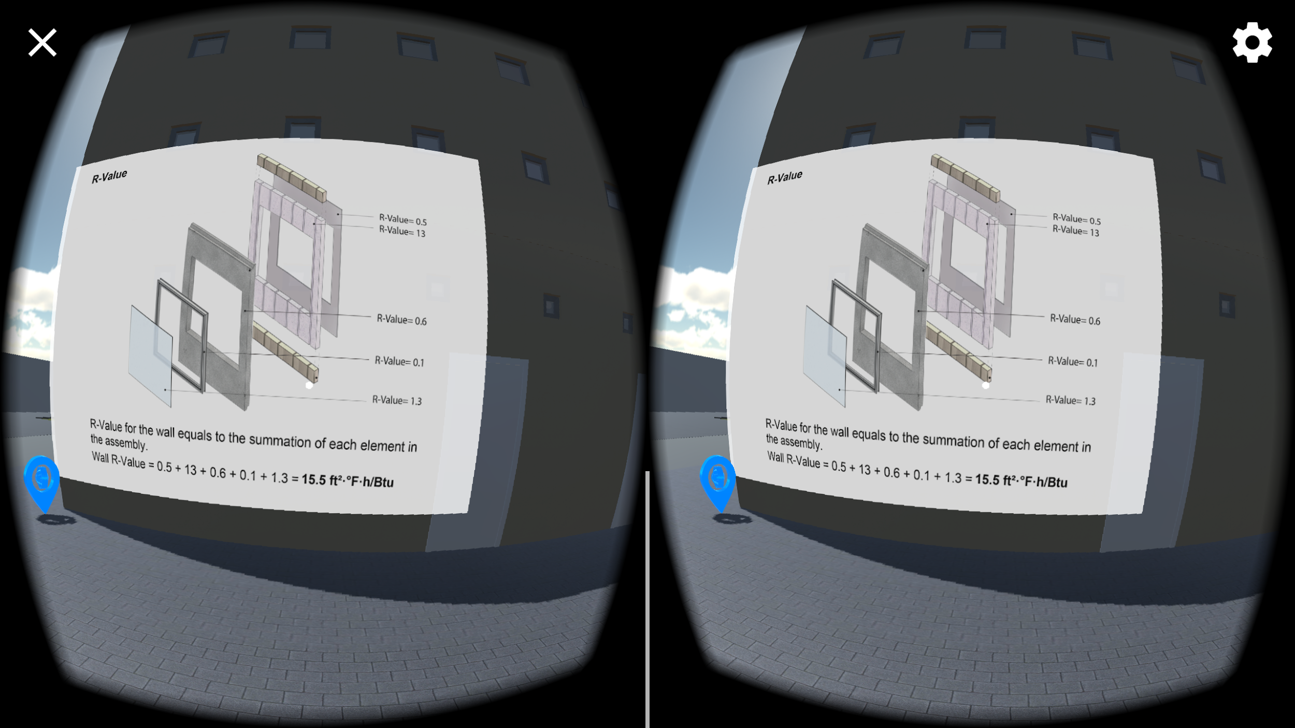
User Story #5 - #230 Icon Camera View
A camera made specifically to render icons and give it priority over other objects.
Camera is attached to main player camera so autowalk is applied to it.
Main purpose is to have a separate camera that can let the user see icons as long as it’s in the line of sight.
Notes:
20 seconds
The tile of user story
Please present and show the complexity of your work, code, algorithms, and technical challenges and technologies you have used. (you could use screenshot if you want. Visual presentations are better than text presentation) - Go into the details of the most important/significant tasks using bullet lists or visual graphs or state chart diagram - Demo using screenshots or GIF (in another separate page if required)
Sequence Diagram for this user story is optional

Slide 13
Test Suites and Test Cases
Test ID: Video_Play
Purpose: Tests if videos are being displayed correctly. Using sunny day test.
Pre-Condition: User opens application, and clicks a video.
Expected Results: Video plays in fullscreen and returns player to same position when finished.
Actual Results: Video plays in fullscreen and returns player to same position when finished.
Status: Pass
Test ID: LAR_Touch_Input_Move
Purpose: Double finger input registers and activates movement scripts. Using Rainy Day test.
Pre-Condition: User has loaded the application and is not facing an icon or building.
Input: Use places one finger on the screen.
Expected Output: The user does not move.
Status: Pass
Notes:
10 seconds
A description of verification process and Test Suites and Test Cases for one of the use cases.
1 One sunny day and one rainy day for the implemented use cases (one or more slides).
2 Automated test scripts for the implemented use cases (if any) (one or more slides).

Slide 14







Summary
Learning with VR was managed using Scrum agile methodology. Project members participated in a 5 bi-weekly sprints. This is the first iteration of this project and will be the first demo build.
Contact Information:
Edvin Li : eli005@fiu.edu
Deon Davis: ddavi133@fiu.edu
Questions?
Thank You!
The logos of all technologies you have used
Notes:
10 seconds
Summarize your contribution, mention your effort for Scrum, Mingle, Github, Google Drive Documentation and minutes
Include your contact information
Ask if anyone has any questions for you.
Thank your audience

